Slide 1
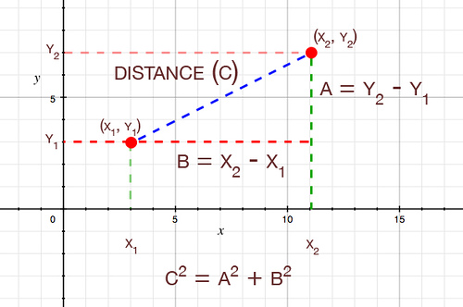
Functions
Function: A chunk of code in a program that has a name and can be executed by using that name.
name of the function
parameters
def distance(x1, y1, x2, y2):
x_diff = (x1 – x2)
y_diff = (y1 – y2)
square_x = x_diff * x_diff
square_y = y_diff * y_diff
return math.sqrt(square_x + square_y)
A function definition

Slide 2
Why use functions?
Organize into logical chunks. Helps:
  Test the program (unit testing)
  Modify the program
  Write correct code
Re-use: Call the function with different values for the parameters
def distance(x1, y1, x2, y2):
...
def average(...):
...
def get_points(...):
...
def maximize(...):
...
def distance(x1, y1, x2, y2):
x_diff = (x1 – x2)
y_diff = (y1 – y2)
square_x = x_diff * x_diff
square_y = y_diff * y_diff
return math.sqrt(square_x + square_y)
d1 = distance(8, 4, 7, 7)
d2 = distance(0, 0, 12, 5)
d3 = distance(5, 3, 9, 20)

Slide 3
A function call
Calling Functions
Call (aka invoke) a function by writing its name followed by parentheses, with the actual arguments to be sent to the function inside those parentheses.
def blah():
...
d = distance(8, 4, 7, 7)
...
def distance(x1, y1, x2, y2):
...
...
...
...
return math.sqrt(square_x + square_y)
Step 4
Step 1
Step 2
distance
( )
Step 3
8, 4, 7, 7
Functions help organize programs and can be re-used with different arguments to get many effects from a single function.
Key idea: The 4-step process when a function is called (as shown above).

